Slide 1




SMART INDIA HACKATHON 2026
TITLE PAGE
  Problem Statement ID –
  Problem Statement Title-
  Theme-
  PS Category- Software/Hardware
  Team ID-
  Team Name (Registered on portal)

Slide 2






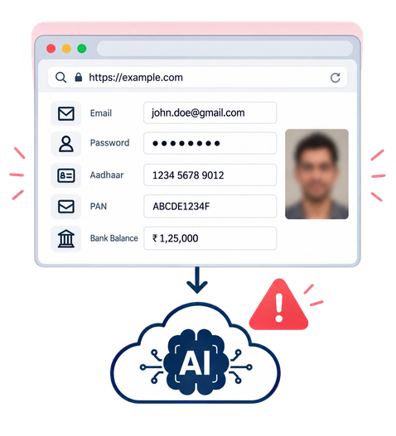






















PRIVYSE
Your Team Name
Privacy-First Visual Perception for Lightweight Browser Agents
See Locally. Sanitize Privately. Act Intelligently.
THE PRIVACY GAP
PROPOSED SOLUTION
PRIVYSE ENABLES SAFE BROWSER AUTOMATION BY DETECTING AND SANITIZING SENSITIVE DATA LOCALLY BEFORE AI PROCESSING.
PROTOTYPE VALIDATION
LOCAL SCREEN PERCEPTION
PRIVACY FILTER
ZERP LEAK
SAFE BROWSER ACTION
SENSITIVE INFO
FACES AND VISUAL PII
DOM PII SCAN
DYNAMIC REDACTION
TRADITIONAL VISUAL BROWSER AGENTS SEND RAW DATA TO AI SYSTEMS
SANITISED SCREENSHOT OCR SCAN
UNDERSTANDS THE CURRENT SCREEN LOCALLY.
ANYNONMOUS
TOKENS
EXECUTE ACTIONS
(CLICK, TYPE, SCROLL, NAVIGATE)
RAW SCREENSHOTS EXPOSE SENSITIVE INFORMATION TO AI
INNOVATION & UNIQUENESS
SANITIZE BEFORE AI
REDACTS DATA ON-DEVICE.
STABLE PII TOKENS
MAINTAINS CONTEXT WITHOUT EXPOSING DATA.
FAIL-CLOSED DESIGN
IF PRIVACY CHECKS FAIL, NOTHING IS SENT.
ELEMENT-ID ACTIONS
ACTS ON RELIABLE UI ELEMENTS.
@SIH Idea submission- Template
2

Slide 3









TECHNICAL APPROACH
Your Team Name
Methodolgy and Process for implementation
Technology Stack
1. Screen Capture & Local Understanding
Capture the active screen and parse UI elements (DOM) locally.
2. Sensitive Data Detection
Detect PII, faces, passwords and other sensitive elements using on-device models.
3. Redaction & Sanitization
Blur/mask sensitive data and replace it with anonymous tokens.
4. AI Reasoning
Send only sanitized context to AI to determine the next action.
5. Browser Action Execution
Execute actions safely such as click, type, scroll and navigate using element IDs.
Repeat until task is completed.
@SIH Idea submission- Template
3

Slide 4
FEASIBILITY AND VIABILITY
Your Team Name
  Analysis of the feasibility of the idea
  Potential challenges and risks
  Strategies for overcoming these challenges
@SIH Idea submission- Template
4

Slide 5
IMPACT AND BENEFITS
Your Team Name
5
@SIH Idea submission- Template

Slide 6
RESEARCH AND REFERENCES
Your Team Name
Research
References
Competitive Landscape:
  0.6B local PII detector—mirrors your project's core goal.
Perplexity PII Tracer
AI browser agents offer different privacy approaches, but all face risks like prompt injection, excessive data collection, and broad data access. Brave Leo stands out with on-device processing, highlighting the need for secure, privacy-focused local browser agents.
  OpenAI's solution for preventing URL-based data exfiltration in AI agents.
OpenAI Link Safety
  Official Income Tax Department portal for PAN's 10-character alphanumeric structure
Indian Sensitive Data:
Income Tax PAN
Indian websites expose 8 sensitive identifier types (Aadhaar, PAN, UPI, IFSC, Voter ID, Driving Licence, Passport, Bank Account) with distinct formats, but detection faces challenges from formatting variations, false positives, and image-based PII. Current system covers emails, phones, Aadhaar, PAN, and cards, but critical gaps remain for UPI, IFSC, bank accounts, and government IDs.
  Official UIDAI page for Aadhaar's 12-digit format and Verhoeff checksum.
UIDAI Aadhaar
  A browser-based document pipeline (PDF → OCR → NER) running entirely locally via WebAssembly/WebGPU.
Redaction Quality
UIDAI Aadhaar
MediaPipe provides fully local face detection in-browser (~2.3MB model), while Tesseract.js (WASM SIMD) and PaddleOCR.js (WebGPU) deliver production-ready OCR (300ms and 97ms per image respectively), all enabled by WebGPU's 3-8× speedup over WebGL—though shader compilation adds 1-5s warm-up time.
  Official Chrome overview of WebGPU, enabling 3×+ speedup over WebGL.
UIDAI Aadhaar
  Microsoft's open-source toolkit for PII detection and redaction in text and images.
UIDAI Aadhaar
Redaction quality is measured via PII detection precision/recall and Masking F2 score (prioritizing recall), with OCR-based leak checking verifying no readable text remains in redacted images. Contextual signals (labels like "PAN," "Aadhaar") boost detection confidence, but a false-positive catalog is essential to avoid over-redaction.
  A benchmark dataset for evaluating masking quality via precision/recall and F2 score.
UIDAI Aadhaar
6
@SIH Idea submission- Template

Slide 7









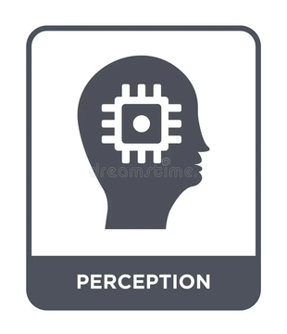




RESEARCH AND REFERENCES
Your Team Name
Research
References
📖
🔗 key sources for our research
Competitive Landscape:
Perplexity PII Tracer
OpenAI Link Safety
Income Tax PAN
AI browser agents share privacy risks like prompt injection and excessive data access; Brave Leo's on-device processing highlights the need for secure local agents.
0.6B local PII detector—mirrors your project's core goal.
OpenAI's solution for preventing URL-based data exfiltration in AI agents.
Official Income Tax Department portal for PAN's 10-character alphanumeric structure
Indian Sensitive Data:
Indian sites expose 8 identifiers (Aadhaar, PAN, UPI, IFSC, Voter ID, DL, Passport, Bank). Covers email, phone, Aadhaar, PAN, cards—gaps: UPI, IFSC, bank, govt IDs.
WebGPU Overview
UIDAI Aadhaar
Scale DP
Official UIDAI page for Aadhaar's 12-digit format and Verhoeff checksum.
A browser-based document pipeline (PDF → OCR → NER) running entirely locally via WebAssembly/WebGPU.
Official Chrome overview of WebGPU, enabling 3×+ speedup over WebGL.
On-Device Perception:
MediaPipe enables local face detection (~2.3MB), while Tesseract.js (300ms) and PaddleOCR.js (97ms) deliver OCR via WebGPU's 3-8× speedup, despite 1-5s warm-up.
Cloudflare AI Bot Management
Redaction Quality:
Microsoft Presidio
PIIMB Benchmark
A benchmark dataset for evaluating masking quality via precision/recall and F2 score.
Cloudflare's solution for classifying and blocking AI bots (Search, Agent, Training) with granular controls.
Redaction quality measured via PII precision/recall & Masking F2 (recall-focused), with OCR leak-checking. Contextual labels boost confidence; false-positive catalog prevents over-redaction.
Microsoft's open-source toolkit for PII detection and redaction in text and images.
6
@SIH Idea submission- Template

Slide 8
IMPORTANT INSTRUCTIONS
Please ensure below pointers are met while submitting the Idea PPT:
  Kindly keep the maximum slides limit up to six (6). ( Including the title slide)
  Try to avoid paragraphs and post your idea in points /diagrams / Infographics /pictures
  Keep your explanation precise and easy to understand
  Idea should be unique and novel.
  You can only use provided template for making the PPT without changing the idea details pointers (mentioned in previous slides).
  You need to save the file in PDF and upload the same on portal. No PPT, Word Doc or any other format will be supported.
  Note - You can delete this slide (Important Pointers) when you upload the details of your idea on SIH portal.
@SIH Idea submission- Template
7

